Slide 1
硬體模擬程式
高少谷

Slide 2
What is this Course all about?
Learn from this course
  Able to use the HSPICE and Cadence (動手做)
Grading
  出席 20%
  作業 40%
  小考 10%
  期中考 30%

Slide 3
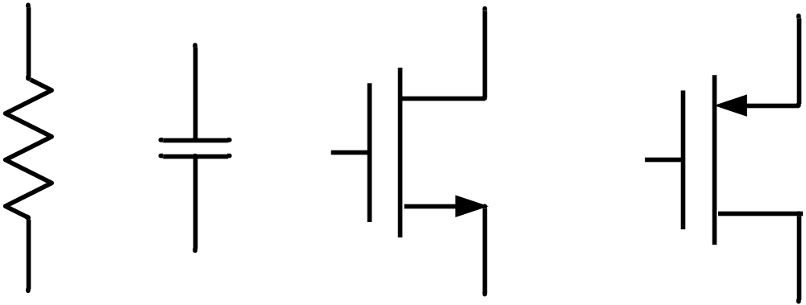
Content of Course
模擬電晶體
(HSPICE)
佈局電晶體
(Cadence Virtuoso)
Simulation tool (HSPICE) [lab1,2]
Layout (Cadence) [lab3,4]

Slide 4
Schedule
Week | Date | Lecture
1 |  | introduction
2
3
4
5
6
7
8
9 |  | Mid-exam
10
11
12
13
14
15
16
17
18

